Slide 1
Facial Recognition using Siamese Networks with Score-Level Fusion
Lokesh Kumar, Bharat Reddy, Sree Vardhan

Slide 2
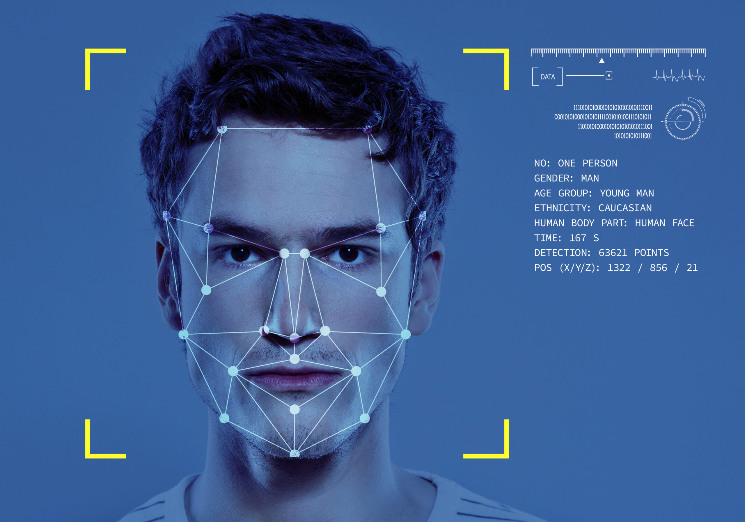
Introduction
Face Recognition Task
source

Slide 3
Introduction
Facial recognition falls under the umbrella of biometric security
Biometric systems can be classified into three types:
Biological biometrics
Morphological biometrics
Behavioural biometrics

Slide 4
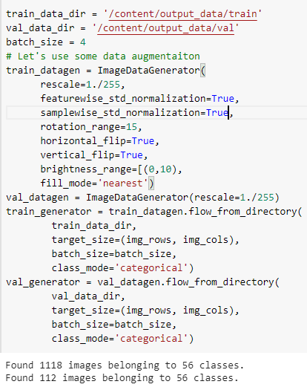
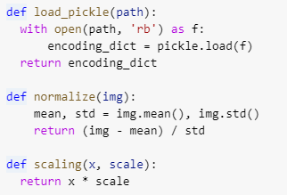
Pre-Processing
Pre-Processing Functions

Slide 5
Face Recognition with Siamese Networks

Slide 6
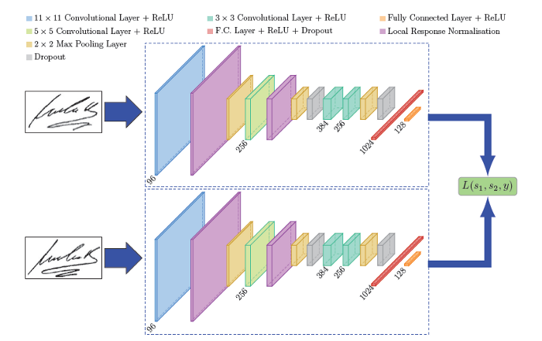
Siamese Networks
Siamese Networks :
A Siamese Neural Network is a class of neural network architectures that contain two or more identical sub-networks.
‘identical’ here means, they have the same configuration with the same parameters and weights.
Parameter updating is mirrored across both sub-networks. It is used to find the similarity of the inputs by comparing its feature vectors
Siamese Networks – An overview
source

Slide 7
Inception Resnet V2

Slide 8
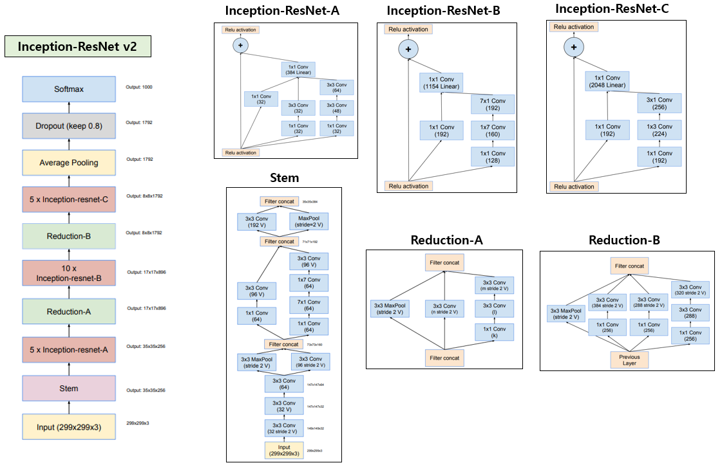
Inception Resnet Architecture
Inception-ResNet-v2 is a convolutional neural architecture that builds on the Inception family of architectures but incorporates residual connections (replacing the filter concatenation stage of the Inception architecture).
Architecture of Inception Resnet v2
source

Slide 9
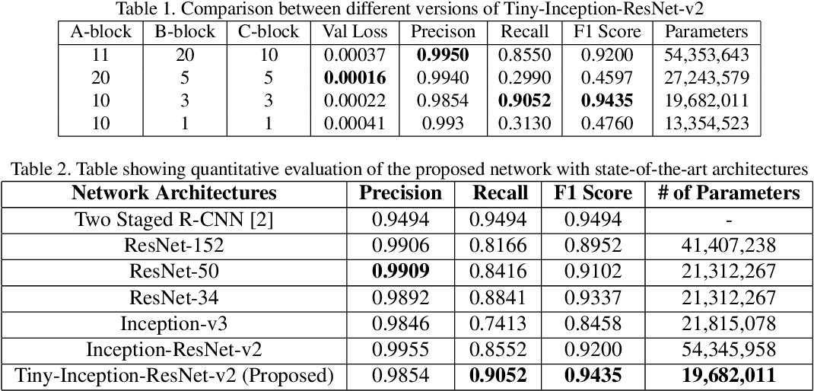
Inception Resnet Architecture
The network is 164 layers deep and can classify images into 1000 object categories, such as keyboard, mouse, pencil, and many animals. As a result, the network has learned rich feature representations for a wide range of images. The network has an image input size of 299-by-299.
Tiny Inception architecture and Comparison metrics
source

Slide 10

Methodology

Slide 11

Our Pipeline
Train-Test split
Standardization
Image Augmentation
Model Selection
Experiments
Training encodings
Score level fusion
Test set validation
Performance metrics
Industry pipeline for ML applications
source

Slide 12
Results

Slide 13
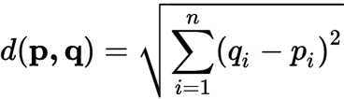
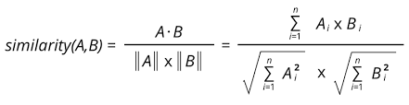
Accuracy Metrics
Euclidean Distance =
Cosine Distance
The Euclidean distance is a straight metric.
The smaller the distance, the better the similarity.
The cosine similarity between two vectors is measured in 'θ'.
If θ = 0°, the 'x' and 'y' vectors overlap, thus proving they are similar.
If θ = 90°, the 'x' and 'y' vectors are dissimilar.

Slide 14
Accuracy Metrics
Without Score Level Fusion
Accuracy = 81.77%
True Predictions = 184/225
Similarity Metric = Euclidean Distance
With Score Level Fusion
Accuracy = 84.00%
True Predictions = 189/225
Similarity Metric = Weighted average of Euclidean distance and Cosine Distance
Weights = [0.3, 0.7]

Slide 15
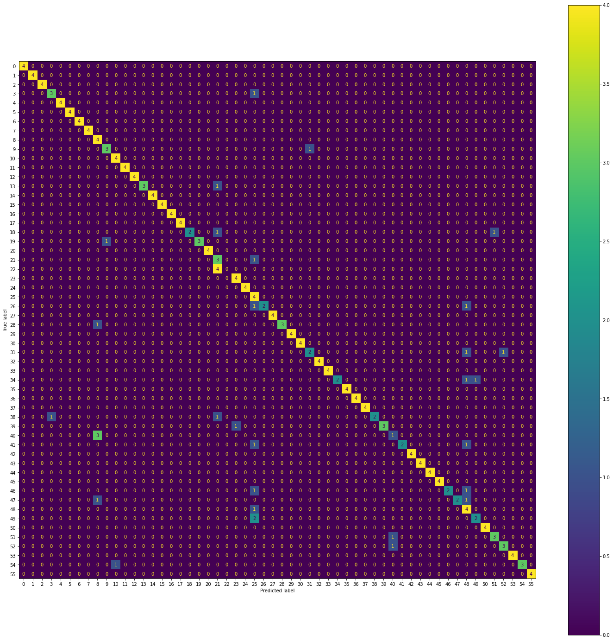
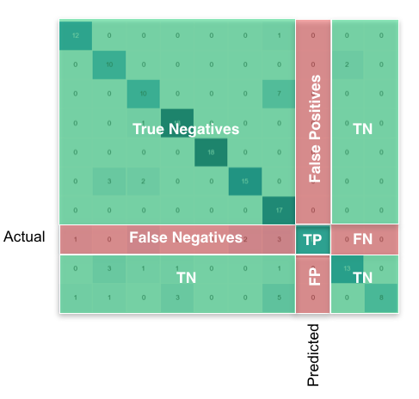
Accuracy Metrics
Indicative Confusion Matrix
Actual Confusion Matrix

Slide 16


ResearchQuestions
Effect of Color Inversion
An Accuracy drop of ~2.8% was observed when the color was inverted.
Facial features in 2D image are independent of spatial data.
Hence, drop in accuracy is negligible.
Inverted image – BGR to Gray

Slide 17



Research Questions
Effect of Image Inversion
Effect of Image Flipping
An Accuracy drop of ~2.8% was observed when the data was inverted.
This can be attributed to the fact that the training data was augmented with this nature.
Hence, drop in accuracy is negligible.
Image flipping example

Slide 18








Research Questions
Performance on different gender
Out of 36 inaccurate predictions, there were 32 images corresponding to males, and 4 images corresponding to females.
Men in the dataset, had facial hair removed in several images which was a part of the test set.
This resulted in the bias.

Slide 19
Conclusion & Future Work
Facial recognition still poses great challenges despite technological advancements in deep learning.
Vision transformers have been gaining traction in the computer vision space especially for recognition tasks.
Since, transformer models effectively convert the image space into an embedding space on different patches, it is much likely to provide better results in this challenge.

Slide 20
Thank you

